Slide 1
DEPARTMENT OF ELECTRONICS AND COMMUNICATION ENGINEERING
REAL TIME BASED SOLDIER HEALTH MONITERING SYSTEM USING GPS AND GSM
by
B. Muralidhar Reddy (20AT1A0489)
Y. Nanda Krishna (20AT1A0493)
K. Raju (20ATIA04B4)
Under the Supervision of Mr. S. TOWSEEF AHMED, M. Tech., (Ph. D) Associate Professor
G PULLAIAH COLLEGE OF ENGINEERING AND TECHNOLOGY
(An Autonomous Institute affiliated to JNTUA, Ananthapuramu)

Slide 2
CONTENTS
Motivation
Objectives
Abstract
Introduction
Block diagram of Proposed method
Explanation of Block diagram
Software Used
References

Slide 3
Motivation
Enhancing Soldier Safety
GPS Integration
GSM Communication

Slide 4
objectives
To The system utilizes GPS technology to track the location of soldiers.
To The system uses GSM technology for seamless communication between soldiers and the monitoring center.
To The system can send immediate alerts to the monitoring center in case of any health emergencies.

Slide 5
ABSTRACT
Our system focuses on monitoring the health of soldiers in real-time. We utilize GPS (Global Positioning System) and GSM (Global System for Mobile Communications) technologies to create an efficient and effective monitoring solution. This system ensures that soldiers' health conditions are constantly tracked and communicated to a central control station. By combining GPS for location tracking and GSM for communication, our solution enhances the safety and well-being of soldiers during their missions, allowing timely intervention in case of any health-related issues.

Slide 6
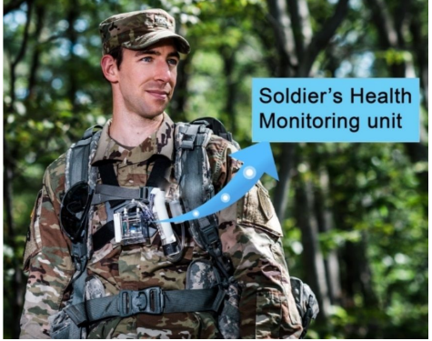
INTRODUCTION
Soldier unit:
Military service are rapidly adopting new inventions and innovations. Army forces are crucial in warfare and their physical health matters as they defend the nation from enemies
Soldier well-being is essential. Protecting them involves tracking their location and movement. This helps the base station ensure their safety and plan effectively.

Slide 7
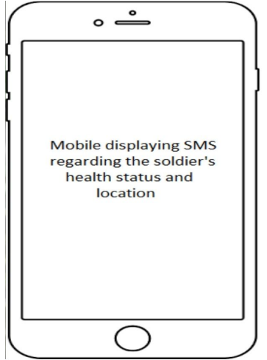
INTRODUCTION
Base unit:
Our project aims to track soldiers' precise locations and monitor their physical health during combat. This information will empower the base station to adapt war strategies accordingly.
The focus of our paper is on utilizing GPS technology to accurately track army members. This system offers valuable insights to the base camp, aiding in the real-time identification of soldiers' health status and positions.

Slide 8
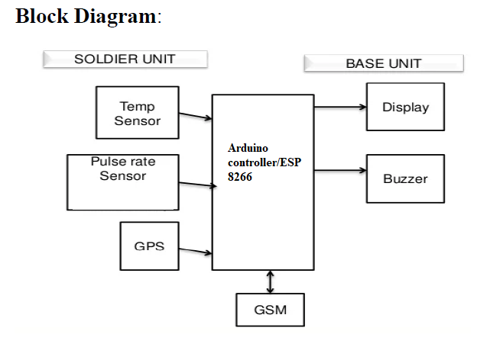
PROPOSED block diagram

Slide 9
Explanation of block diagram
It consists :
Power supply
Temperature sensor
Panic Button
Microcontroller
GSM and GPS
Heartbeat sensor
LCD

Slide 10
Explanation of block diagram
Transmitter:
Components: power supply board with Bridge Rectifiers, Capacitors, Resistors, and PIC16F877A microcontroller.
Function: Collects data from GPS, GSM, and biomedical sensors (pressure, oxygen, heart rate, temperature).
LCD Display: Displays "Soldier Health Monitoring System" during startup.

Slide 11
Explanation of block diagram
Sensor Data: Each sensor provides measurements.
Threshold Logic: If sensor values are within threshold, display "N" (normal), otherwise "H" (high) and alert predefined contacts.
Receiver:
Components: Cell phone with SIM card (receives messages), base station.
Function: Receives soldier's messages and alerts from transmitter.

Slide 12
Explanation of block diagram
Alert Message: If sensor values are abnormal or soldier initiates a danger alert, a message is sent.
Data Interpretation: Normal/abnormal status and danger alert are indicated.
Communication: Cell phone receives messages, processes alerts, and communicates with the base station.

Slide 13
Flowchart

Slide 14

SOFTWARE TOOL USED
The Arduino UNO IDE is a software development environment used for programming Arduino boards. It allows users to write, compile, and upload code to their Arduino devices. It supports a simplified programming language based on C/C++.

Slide 15
refErences
Arya V Nair, Rani Raju, Tinsa Elsa Thomas and Vidya R Nair, “IoT Based Soldier Monitoring System” ,Pramana Research Journal,Volume No:9, Issue:5, pp: 157-165,2019.
Brijesh Iyer and Niket Patil, “IoT enabled tracking and monitoring sensor for military applications”, International Journal of Systems Assurance Engineering and Management, SPRINGER, July-2018.
D. Poornakumar, R. Periyanayaki, M. R. Pradheepa, N. Prakashkumar and S. Nandhini ,“Soldiers Navigation and Health Monitoring System using GPS and GSM”, International Journal of Research in Engineering Science and Management, Volume No: 3,Issue:4,pp:115-158,April-2020.

Slide 16
QUERIES?

Slide 17
THANK YOU

